Slide 1

01
Project Proposal
AI Agent for Customer Support

Slide 2
02
The Future is Agentic
“There will be more AI agents than people, reflecting our values and interacting on our behalf.” - Mark Zuckerberg
“AI agents will become the primary way we interact with computers, understanding our needs and helping us proactively.” - Satya Nadella
“By 2024, AI will power 60% of personal device interactions, especially among Gen Z.” - Sundar Pichai

Slide 3
Why Existing Chatbot Ineffective
03
Limited Context Understanding
Predefined, Rigid Responses
Lack of Learning from Interactions
Poor Multi-Turn Conversation Handling
Ineffective Escalation Mechanisms

Slide 4
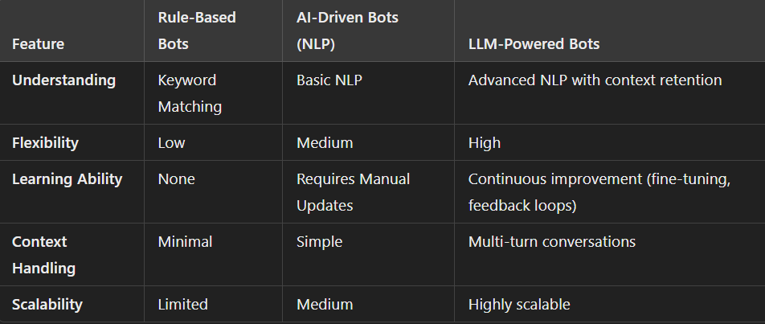
Traditional vs Agentic Bot
04

Slide 5
05
Let’s Design the Prototype

Slide 6
06
Data Collection and Preparation
Gather historical customer interaction data (e.g., chat logs, emails).
Collect FAQs, manuals, and other knowledge base resources.
Clean, label, and structure data for training and testing.
Identify gaps in knowledge base and update accordingly.
Ensure compliance with data privacy regulations (GDPR, CCPA).

Slide 7
AI Model Selection and Development
07
Choose an LLM like GPT-4 or an open-source alternative.
Fine-tune the model with domain-specific data.
Implement a Retrieval-Augmented Generation (RAG) pipeline.
Test model performance for intent recognition and accuracy.
Continuously optimize the model for specific business needs.
Using ReAct for Escala

Slide 8
08
Backend Architecture
Design modular architecture for scalability.
Use APIs to connect the AI agent with CRMs, databases, and external systems.
Deploy a vector database (e.g., Pinecone, Weaviate) for semantic search.
Implement user authentication and data encryption mechanisms.
Use containerization (Docker) for deployment and scalability.

Slide 9
09
Frontend Development
Design intuitive chatbot UI/UX for web and mobile.
Develop cross-platform support for web, mobile apps, and messaging platforms.
Integrate user-friendly features like quick replies and feedback buttons.
Test UI responsiveness across devices.
Incorporate accessibility features (e.g., screen reader compatibility).

Slide 10
10
Integration
Connect the AI agent to CRMs (Salesforce, HubSpot) for personalized responses.
Link with live data systems for real-time query resolution.
Sync with ticketing systems for query escalation.
Test API calls for accuracy and speed.
Validate integration with messaging platforms (WhatsApp, Messenger).

Slide 11
Testing and Validation
11
Perform unit tests for backend modules.
Conduct end-to-end tests on the chatbot workflow.
Simulate user queries to validate accuracy and relevance.
Gather internal feedback and refine responses.
Test scalability under simulated high traffic.

Slide 12
Deployment
12
Host the AI agent on a cloud platform (AWS, GCP, Azure).
Configure auto-scaling for traffic spikes.
Secure production environment with firewalls and encryption.
Monitor real-time performance metrics post-deployment.
Deploy version control and rollback mechanisms.

Slide 13
13
Thank you!
Feel Free to Ask Questions

